Slide 1
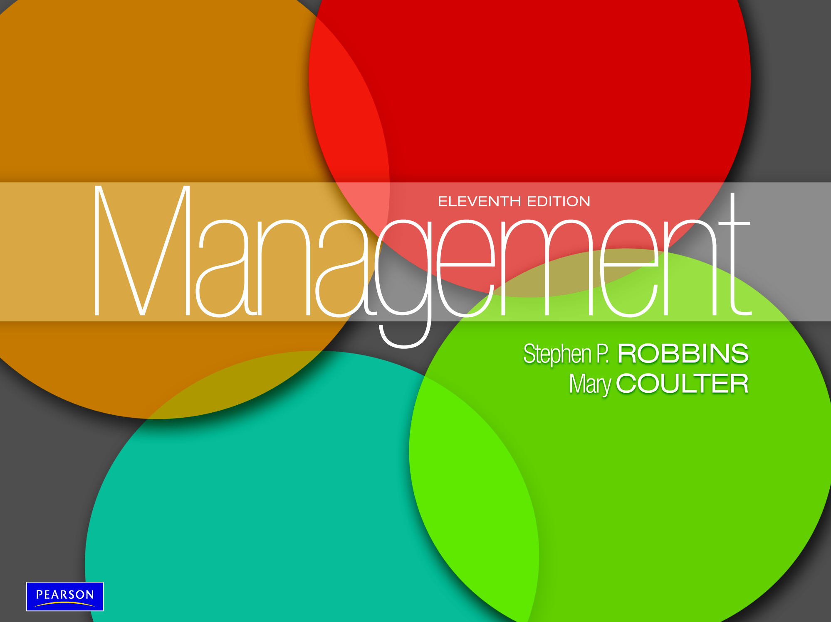

Slide 2

Describe the eight steps in the decision-
making process
Explain the four ways managers make decisions
Classify decisions and decision-making
conditions
Describe different decision-making styles and discuss how biases affect decision making.
Identify effective decision-making techniques

Slide 3
Decision Making
Decision - making a choice from two or more alternatives.

Slide 4
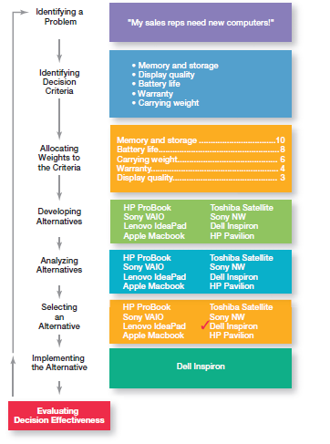
Exhibit 7-1: Decision-Making Process

Slide 5
Step 1: Identifying a Problem
PROBLEM is a discrepancy between an existing and a desired condition.
An obstacle that makes it difficult to achieve a desired goal or purpose.
Characteristics of Problems
  A problem becomes a problem when a manager becomes aware of it.
  The manager must have the authority, information, or resources needed to solve the problem.

Slide 6
Step 2: Identifying Decision Criteria
Decision criteria are factors that are important (relevant) to resolving the problem, such as:
  Costs that will be incurred (investments required)
  Risks likely to be encountered (chance of failure)
  Outcomes that are desired (growth of the firm)
Every decision maker has criteria guiding his or her decisions

Slide 7
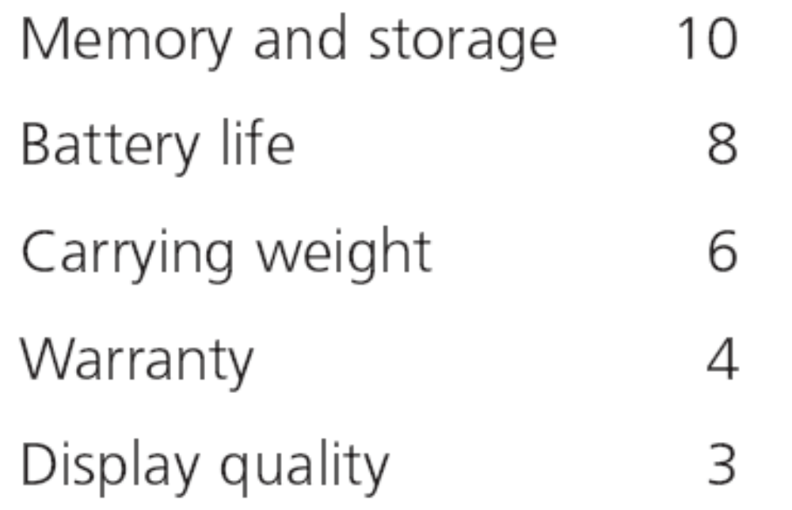
Exhibit 7-2: Important Decision Criteria

Slide 8
Step 3: Allocating Weights to the Criteria
Decision criteria are not of equal importance:
  Assigning a weight to each item places the items in the correct priority order of their importance in the decision-making process.

Slide 9
Step 4: Developing Alternatives
The fourth step in the decision-making process requires the decision maker to list viable alternatives that could resolve the problem.
In this step, a decision maker needs to be creative.
Alternatives are listed (without evaluation) that can resolve the problem.

Slide 10
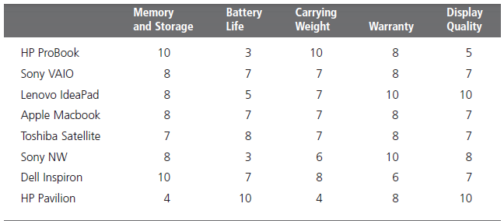
Exhibit 7-3: Possible Alternatives

Slide 11
Step 5: Analyzing Alternatives
Appraising each alternative’s strengths and weaknesses
  An alternative’s appraisal is based on its ability to resolve the issues related to the criteria and criteria weight.

Slide 12
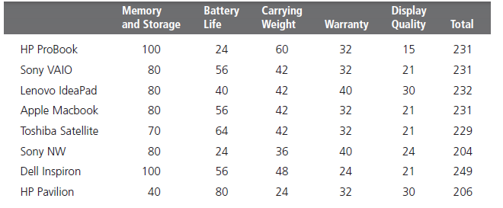
Exhibit 7-4: Evaluation of Alternatives

Slide 13
Step 6: Selecting an Alternative
Choosing the best alternative
  The alternative with the highest total weight is chosen.

Slide 14
Step 7: Implementing the Alternative
Putting the chosen alternative into action
  - Conveying the decision and gaining commitment from those who will carry out the alternative

Slide 15
Step 8: Evaluating Decision Effectiveness
It involves evaluating the outcome or result of the decision to see whether the problem was resolved.
If the evaluation shows that the problem still exists, then the manager needs to assess what went wrong.
  Was the problem incorrectly defined?
  Were errors made when evaluating alternatives?
  Was the right alternative selected but poorly implemented?
The answers might lead you to re-do an earlier step or might even require starting the whole process over.

Slide 16
Decisions Managers May Make
Decision making is particularly important to managers.
It’s part of all four managerial functions.
Decision making is the essence of management. And that’s why managers—when they plan, organize, lead, and control—are called decision makers.

Slide 17
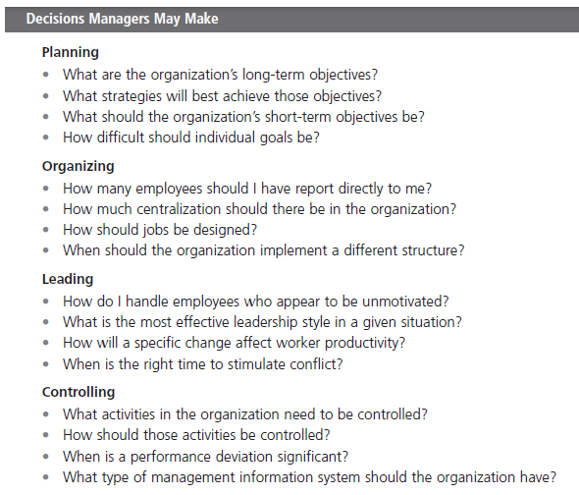
Exhibit 7-5: Decisions Managers May Make

Slide 18
Four ways managers make decisions
Rational Decision-Making
Bounded Rationality Decision-Making
Intuitive decision- making
Evidence-based management (EBMgt)

Slide 19
Four ways managers make decisions
1. Rational Decision-Making
The problem faced would be clear and unambiguous, and the decision maker would have a clear and specific goal and know all possible alternatives and consequences.
Finally, making decisions rationally would consistently lead to selecting the alternative that maximizes the likelihood of achieving that goal.

Slide 20
Four ways managers make decisions
2. Bounded Rationality - decision making that’s rational, but limited (bounded) by an individual’s ability to process information.
managers satisfice rather than maximize.
Satisfice - accepting solutions that are “good enough.”

Slide 21
Bounded Rationality Example:
Suppose that you’re a finance major and upon graduation you want a job, preferably as a personal financial planner, with a minimum salary of $35,000 and within a hundred miles of your hometown. You accept a job offer as a business credit analyst—not exactly a personal financial planner but still in the finance field—at a bank 50 miles from home at a starting salary of $34,000. If you had done a more comprehensive job search, you would have discovered a job in personal financial planning at a trust company only 25 miles from your hometown and starting at a salary of $38,000. You weren’t a perfectly rational decision maker because you didn’t maximize your decision by searching all possible alternatives and then choosing the best. But because the first job offer was satisfactory (or “good enough”), you behaved in a bounded rationality manner by accepting it.

Slide 22
Four ways managers make decisions
3. Intuitive decision- making
Making decisions on the basis of experience, feelings, and accumulated judgment.
Researchers studying managers’ use of intuitive decision making have identified five different aspects of intuition,

Slide 23
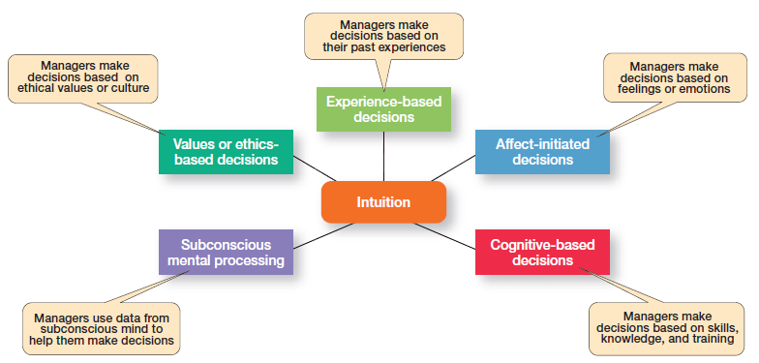

Slide 24
Four ways managers make decisions
4. Evidence-based management (EBMgt)
“systematic use of the best available evidence to improve management practice.
Four essential elements of EBMgt:
  expertise and judgment.
  external evidence.
  opinions, preferences, and values of those who have a stake in the decision.
  relevant organizational (internal) factors such as context, circumstances, and organizational members.

Slide 25
Types of Problems
Structured Problem - Straightforward, familiar, and easily defined problems.
Unstructured problem - Problems that are new or unusual and for which information is ambiguous or incomplete

Slide 26
Types of Decisions
Programmed Decision - a repetitive decision that can be handled by a routine approach.
(Decisions used to solve the structured problems).
Non-programmed Decisions - unique and nonrecurring decisions that require a custom-made solution.
(Decisions used to solve the unstructured problems).

Slide 27
Types of Programmed Decisions
Procedure - a series of interrelated steps that a manager can use to apply a policy in response to a structured problem.
Rule - an explicit statement that limits what a manager or employee can or cannot do.

Slide 28
Types of Programmed Decisions
3. Policy - a general guideline for making a decision about a structured problem.
a policy establishes general parameters for the decision maker rather than specifically stating what should or should not be done.
Policies typically contain an ambiguous term that leaves interpretation up to the decision maker.

Slide 29
3. Policy Cont……..
Here are some sample policy statements:
  The customer always comes first and should always be satisfied.
  Employee wages shall be competitive within community standards.
  Notice that the terms satisfied and competitive require interpretation

Slide 30
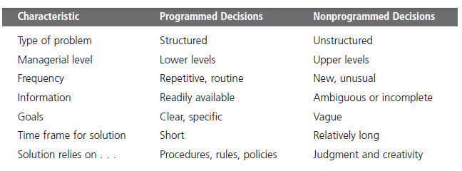
Exhibit 7-7: Programmed Versus
Non-programmed Decisions

Slide 31
Decision-Making Situations
Certainty:
  a situation in which a manager can make an accurate decision because the outcome of every alternative choice is known.
Risk:
  a situation in which the manager is able to estimate the likelihood (probability) of outcomes that result from the choice of particular alternatives.

Slide 32
Decision-Making Situations
3. Uncertainty: a situation in which the outcome is unknown and manager is unable to estimate the likelihood (probability) of outcomes that result from the choice of particular alternatives.
Under these conditions, the choice of alternative is influenced by the limited amount of available information and by the psychological orientation of the decision maker (Optimistic Vs pessimistic).

Slide 33
Uncertainty Cont…………..
Limited information forces managers to rely on intuition and hunches.
    Maximax: the optimistic manager’s choice to maximize the maximum payoff.
    Maximin: the pessimistic manager’s choice to maximize the minimum payoff.
    Minimax: the manager’s choice to minimize maximum regret.

Slide 34
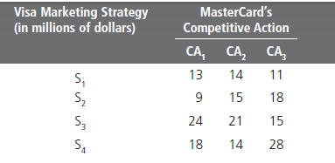
Exhibit 7-9: Payoff Matrix

Slide 35
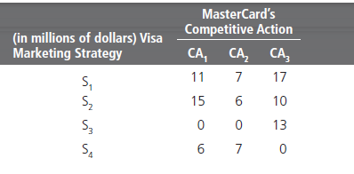
Exhibit 7-10: Regret Matrix

Slide 36
Decision-Making Styles
Linear Thinking Style - a person’s tendency to use external data/facts; the habit of processing information through rational, logical thinking.
Nonlinear Thinking Style - a person’s preference for internal sources of information; a method of processing this information with internal insights, feelings, and hunches.

Slide 37
Decision-Making Biases and Errors
Heuristics - using “rules of thumb” to simplify decision making.
Overconfidence Bias - holding unrealistically positive views of oneself and one’s performance.
Immediate Gratification Bias - choosing alternatives that offer immediate rewards and avoid immediate costs.

Slide 38
Decision-Making Biases and Errors (cont.)
Anchoring Effect - fixating on initial information and ignoring subsequent information.
Selective Perception Bias - selecting, organizing and interpreting events based on the decision maker’s biased perceptions.
Confirmation Bias - seeking out information that reaffirms past choices while discounting contradictory information.

Slide 39
Decision-Making Biases and Errors (cont.)
Framing Bias - selecting and highlighting certain aspects of a situation while ignoring other aspects.
Availability Bias - losing decision-making objectivity by focusing on the most recent events.
Representation Bias - drawing analogies and seeing identical situations when none exist.
Randomness Bias - creating unfounded meaning out of random events.

Slide 40
Decision-Making Biases and Errors (cont.)
Sunk Costs Errors - forgetting that current actions cannot influence past events and relate only to future consequences.
Self-Serving Bias - taking quick credit for successes and blaming outside factors for failures.
Hindsight Bias - mistakenly believing that an event could have been predicted once the actual outcome is known (after-the-fact).

Slide 41
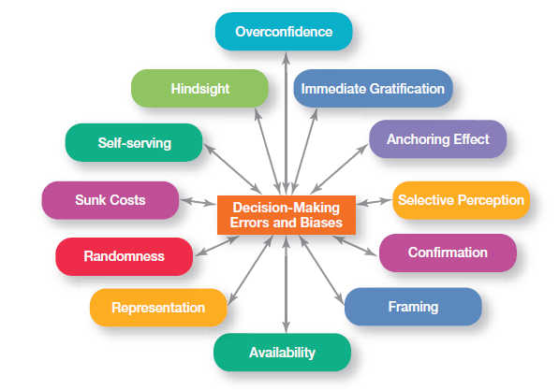
Exhibit 7-10: Common Decision-Making Biases

Slide 42
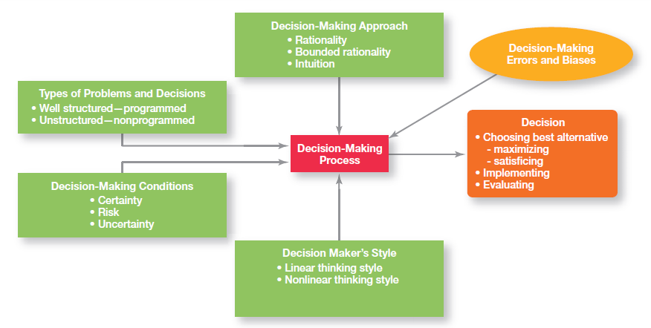
Exhibit 7-12: Overview of Managerial Decision Making

Slide 43
Decision Making for Today’s World
Guidelines for making effective decisions:
  Understand cultural differences
  Know when it’s time to call it quits
  Use an effective decision making process
  Build highly reliable organizations (HROs): (5 habits)
      Are not tricked by their success
      Defer to the experts on the front line
      Let unexpected circumstances provide the solution
      Embrace complexity
      Anticipate, but also anticipate their limits

Slide 44
Terms to Know
Decision criteria
Rational decision making
Bounded rationality
Satisfice
Escalation of commitment
Intuitive decision making
Evidence-based management (EBMgt)
Structured problems
Programmed decision
Procedure
Rule
Policy
Unstructured problems
Nonprogrammed decisions
Risk
Linear thinking style
Nonlinear thinking style
Heuristics

Slide 45


